Slide 2
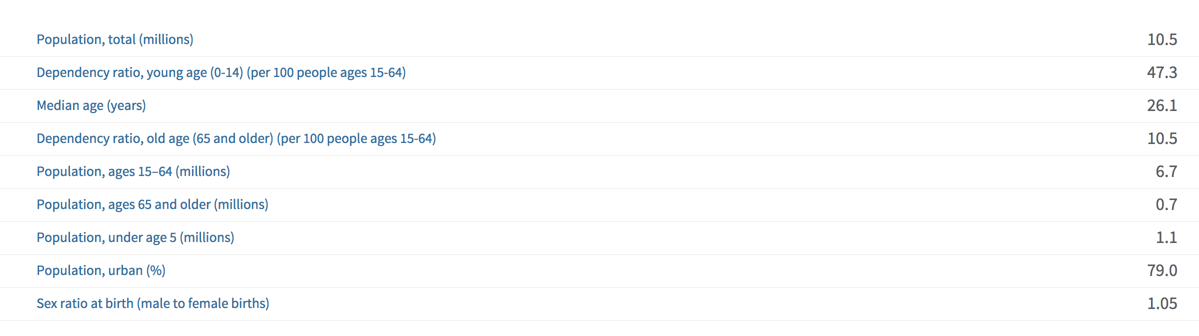

Slide 5
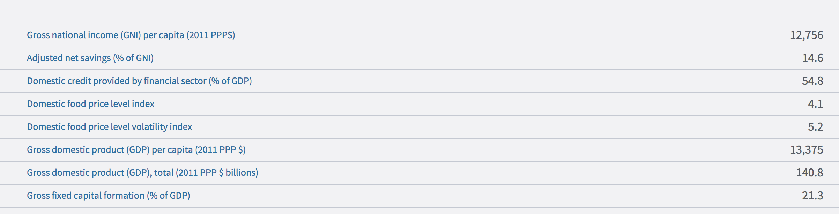

Slide 6
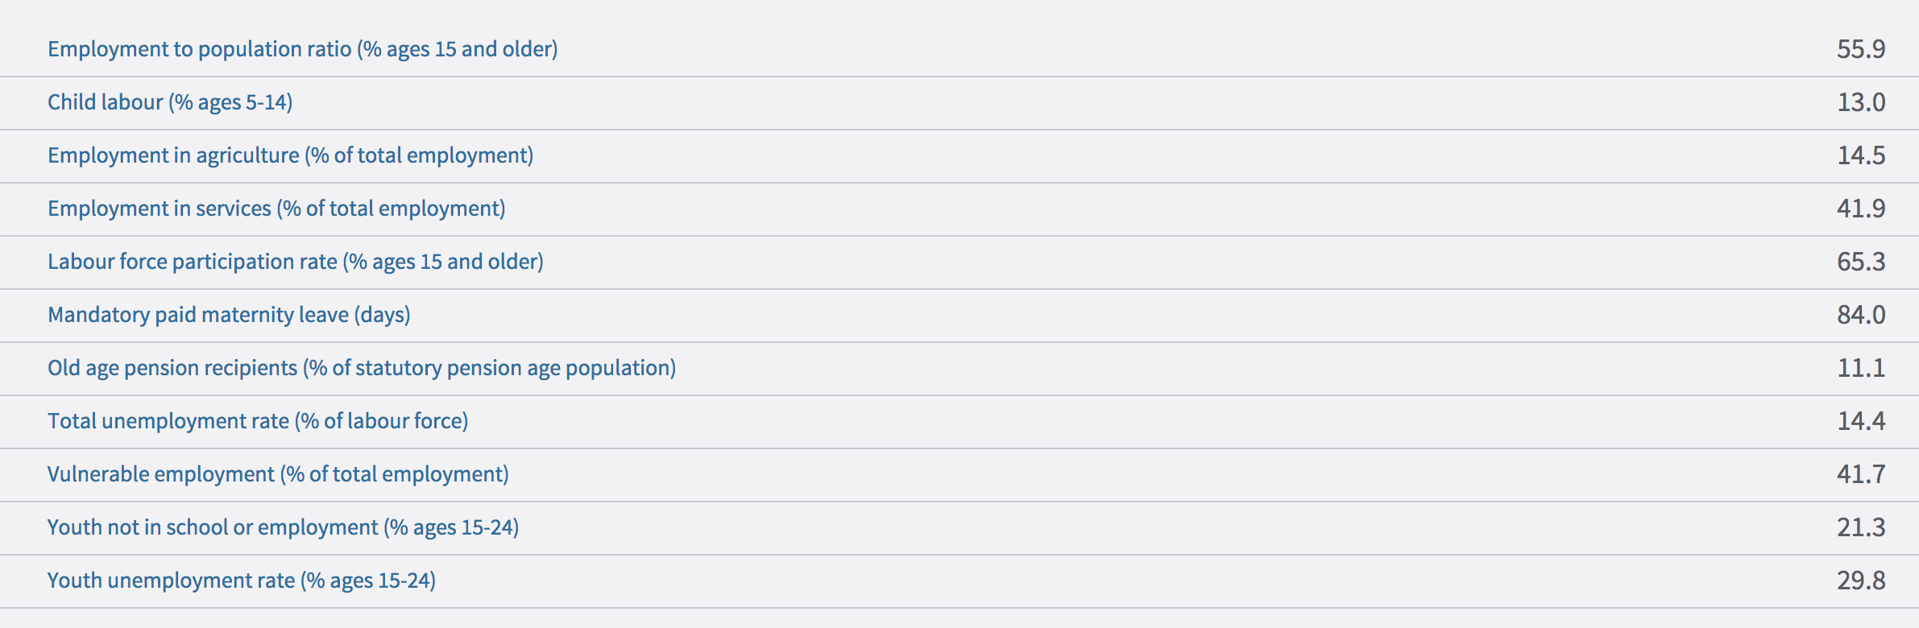

Slide 7
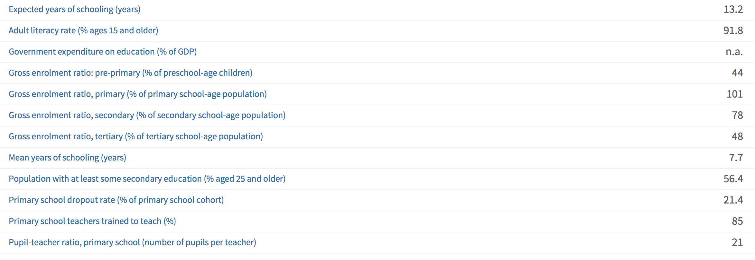

Slide 8
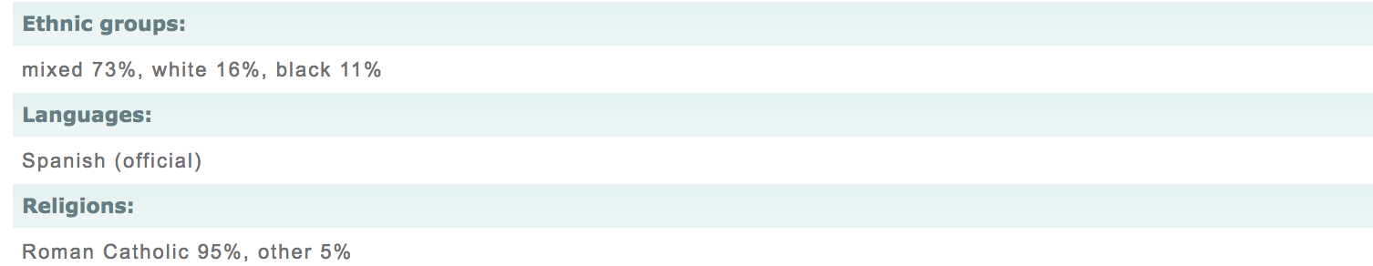
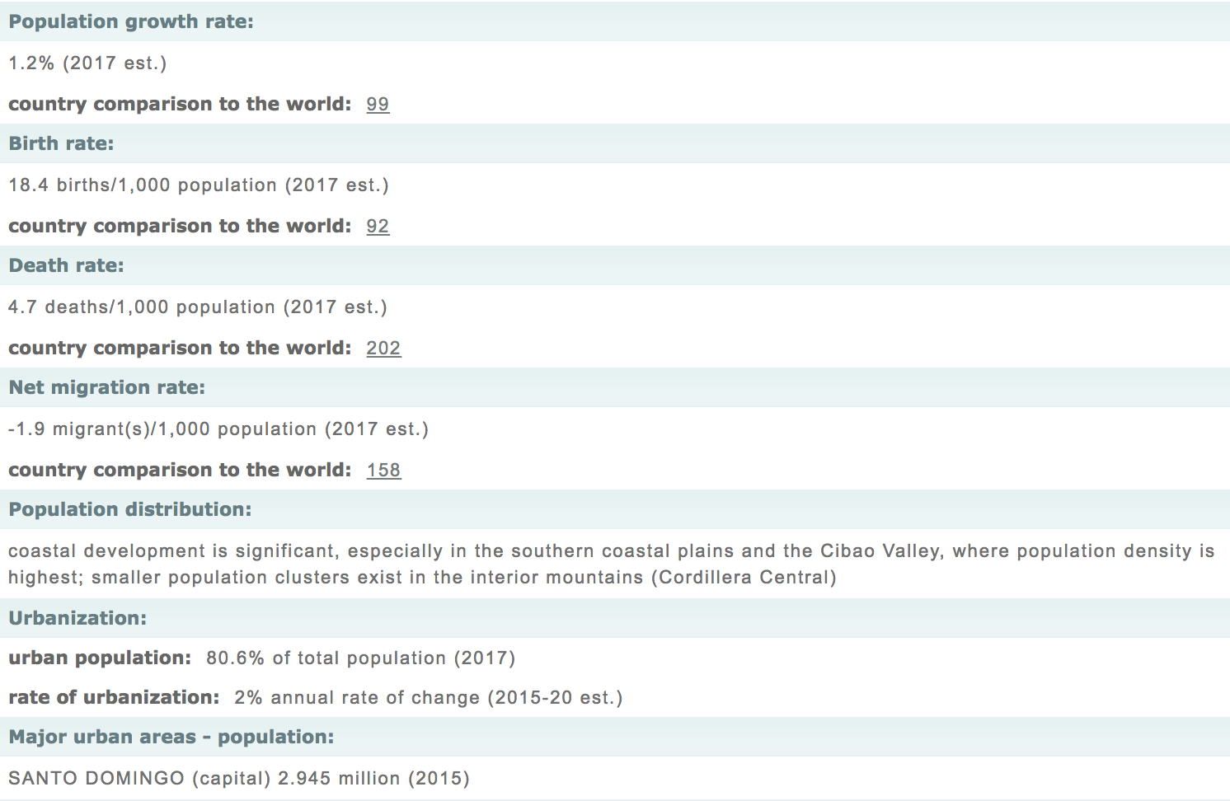

Slide 9
political unrest
unstable economy
high unemployment
level of violence that underscores society
Crime prevalent
Tourists asked to pay attention
Agriculture main industrial sector

Slide 10
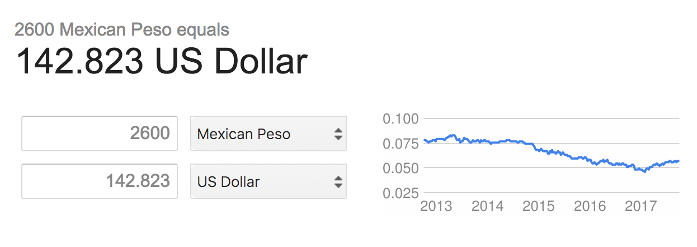
Minimum Wage per month in agricultural sector

Slide 11
References
https://www.cia.gov/library/publications/the-world-factbook/geos/dr.html
http://hdr.undp.org/en/countries/profiles/DOM
http://www.dominicanrepublic.com/demographics/

